Slide 1
Marketing Scheme

Slide 2
Social campaign
In case of :
Pringles and chipsy

Slide 3
Set campaign objectives
Define your audience
Measurement and KPIs
Set budgets and run dates
Design creative content
Five Key steps for creating social media campaign

Slide 4
1
Set campaign objectives
The first step in designing an effective campaign is to set objectives that can be achieved with digital marketing

Slide 5
Campaign Objectives:
1
2
Pringles
Chipsy
Increase market share
Increase profit

Slide 6
2
Define your audience
Every campaign should have a clearly defined target audience. Social media advertising allows us to be precise with who sees our messaging.

Slide 7
Target personas:
1
2
Pringles
Chipsy
Both males and females, between ages of 7-15, and interested in trying products with colorful and good design
Both males and females, between ages of 14-40, and interested in consuming snacks

Slide 8
3
Measurement and KPIs
It's best to measure the effectiveness of social activity.
It's important to assign KPIs, as they are the metrics tracked in order to understand whether or not a campaign is meeting business goals.

Slide 9
KPI:
1
2
Pringles
Chipsy
Increase market share by 35%
Increase profit by 10%

Slide 10
4
Set budgets and run dates
Decide how much to spend on each social channel, and when to start the campaign

Slide 11
Budget and Run date
1
2
Pringles
Chipsy
$500,000
During summer-break
$50,000
During April
Budget
Run date

Slide 12
5
Design creative content

Slide 13
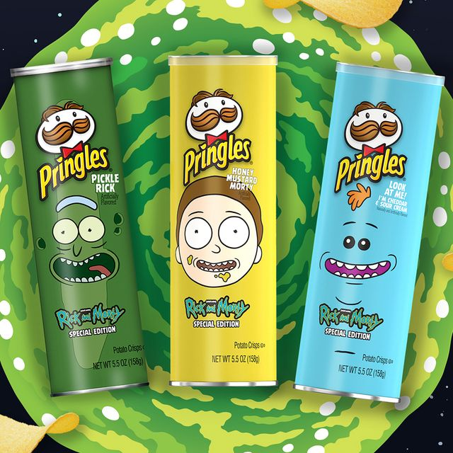


Slide 14




Slide 15
Thank you

